Slide 1
A CD of this message will be available (free of charge) immediately following today's message
This message will be available via podcast later this week at calvaryokc.com
2 Samuel
19-20

Slide 2
2 Samuel
19-20
C. H. Spurgeon ~ "If your dear ones are dead you cannot restore them to life by your unbelief; and if they still survive, it will be a pity to be downcast and unbelieving when there is no occasion for it. 'Your strength is to sit still.' Remember that you are a Christian, and a Christian is expected to be more self-possessed than those who have no God to fly to."

Slide 3
2 Samuel
19-20

Slide 4
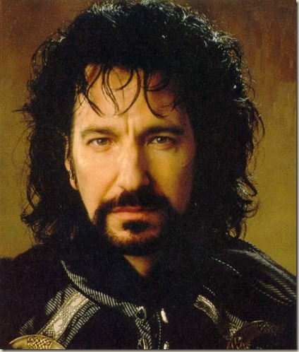
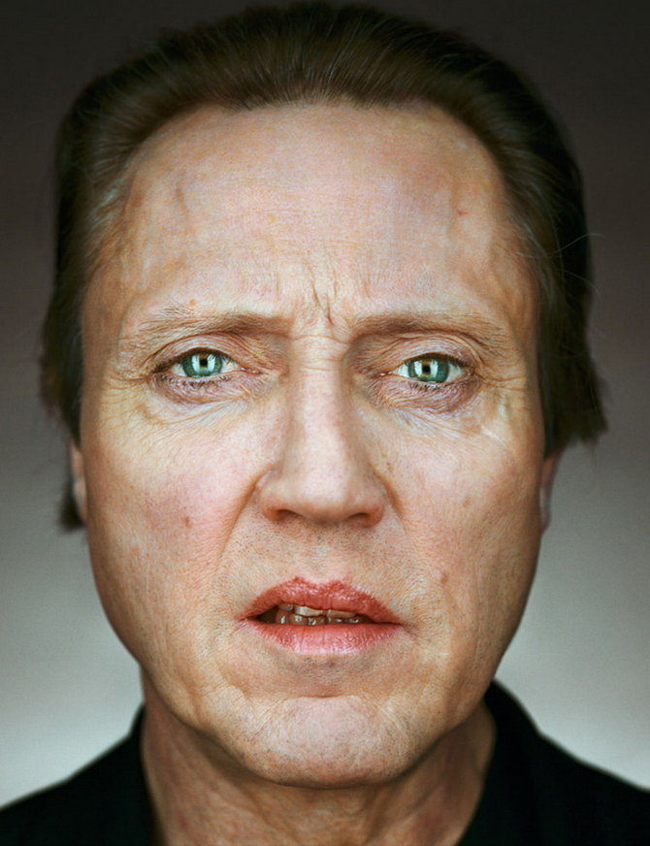
2 Samuel
19-20

Slide 5
2 Samuel
19-20

Slide 6
2 Samuel
19-20
Others May, But You Cannot
by G. D. Watson
If God has called you to be really like Jesus He will draw you into a life of crucifixion and humility, and put upon you such demands of obedience, that you will not be able to follow other people, or measure yourself by other Christians, and in many ways He will seem to let other people do things which He will not let you do.

Slide 7
2 Samuel
19-20
Others May, But You Cannot
by G. D. Watson
Other Christians and ministers who seem very religious and useful, may push themselves, pull wires, and work schemes to carry out their plans, but you cannot do it, and if you attempt it, you will meet with such failure and rebuke from the Lord as to make you sorely penitent.

Slide 8
2 Samuel
19-20
Others May, But You Cannot
by G. D. Watson
Others may boast of themselves, of their work, of their successes, of their writings, but the Holy Spirit will not allow you to do any such thing, and if you begin it, He will lead you into some deep mortification that will make you despise yourself and all your good works.

Slide 9
2 Samuel
19-20
Others May, But You Cannot
by G. D. Watson
Others may be allowed to succeed in making money, or may have a legacy left to them, but it is likely God will keep you poor, because He wants you to have something far better than gold, namely, a helpless dependence upon Him, that He may have the privilege of supplying your needs day by day out of an unseen treasury.

Slide 10
2 Samuel
19-20
Others May, But You Cannot
by G. D. Watson
The Lord may let others be honored and put forward, and keep you hidden in obscurity, because He wants to produce some choice fragrant fruit for His coming glory, which can only be produced in the shade. He may let others be great, but keep you small. He may let others do a work for Him and get the credit for it, but He will make you work and toil on without knowing how much you are doing; and then to make your work still more precious He may let others get credit for the work which you have done, and thus make YOUR REWARD TEN TIMES
GREATER WHEN JESUS COMES.

Slide 11
2 Samuel
19-20
Others May, But You Cannot
by G. D. Watson
The Holy Spirit will put a strict watch over you, with a jealous love, and will rebuke you for little words and feelings or for wasting your time, which other Christians never feel distressed over. So make up your mind that God is an Infinitely Sovereign Being, and has a right to do as He pleases with His own. He may not explain to you a thousand things which puzzle your reason in His dealings with you, but if you absolutely sell yourself to be His love slave, He will wrap you up in Jealous Love, and bestow upon you many blessings which come only to those who are in the
inner circle.

Slide 12
2 Samuel
19-20
Others May, But You Cannot
by G. D. Watson
Settle it forever, then that you are to DEAL DIRECTLY WITH THE HOLY SPIRIT, and that He is to have the privilege of tying your tongue, or chaining your hand, or closing your eyes, in ways that He does not seem to use with others. Now, when you are so possessed with the living God that you are, in your secret heart, pleased and delighted over this PECULIAR, PERSONAL, PRIVATE, JEALOUS GUARDIANSHIP AND MANAGEMENT OF THE HOLY SPIRIT OVER YOUR LIFE, then you will have found the vestibule of Heaven.

Slide 13
2 Samuel
19-20

Slide 14
2 Samuel
19-20
Rebel ~ KJV, man of Belial

Slide 15
2 Samuel
19-20

Slide 16
2 Samuel
19-20
Prov. 6:16-19 ~ ¹⁶ These six things the Lord hates,
Yes, seven are an abomination to Him:
¹⁷ A proud look,
A lying tongue,
Hands that shed innocent blood,
¹⁸ A heart that devises wicked plans,
Feet that are swift in running to evil,
¹⁹ A false witness who speaks lies,
And one who sows discord among brethren.

Slide 17
2 Samuel
19-20

Slide 18
2 Samuel
19-20
Adam Clarke ~ "He could not well divorce them; he could not punish them, as they were not in the transgression; he could not more be familiar with them, because they had been defiled by his son; and to have married them to other men might have been dangerous to the state."

Slide 19
2 Samuel
19-20

Slide 20
2 Samuel
19-20
NLT ~ As he stepped forward to greet Amasa, he secretly slipped the dagger from its sheath.

Slide 21
2 Samuel
19-20

Slide 22
2 Samuel
19-20
Are you in health ~ literally, shalom

Slide 23
2 Samuel
19-20

Slide 24
2 Samuel
19-20
Deut. 20:10-11 ~ ¹⁰ When you go near a city to fight against it, then proclaim an offer of peace to it. ¹¹ And it shall be that if they accept your offer of peace, and open to you, then all the people who are found in it shall be placed under tribute to you, and serve you.

Slide 25
2 Samuel
19-20

